Slide 1


Heart Disease Prediction using Machine Learning
Presented by
Sahil Chikhale
Nikita Sawkare
Akshay Kurkunde
Mayur Autade
Under the Guidance of
Prof. Sushmita Khalane
Department of Computer Engineering,
SITRC, Nashik
Sandip Institute of Technology and Research Center, Nashik

Slide 2
Content
Introduction
Workflow diagram
Literature review
Problem Statement
Objective
Proposed Work
Result Analysis
Conclusion
Future Scope
References

Slide 3
Introduction
A lot of people suffer from cardiovascular diseases (CVDs), which even cost people their lives all around the world
Machine learning can be used to detect whether a person is suffering from a cardiovascular disease by considering certain attributes like chest pain, cholesterol level, age of the person and some other attributes
Classification algorithms based on supervised learning which is a type of machine learning can make diagnoses of cardiovascular diseases easy.

Slide 4
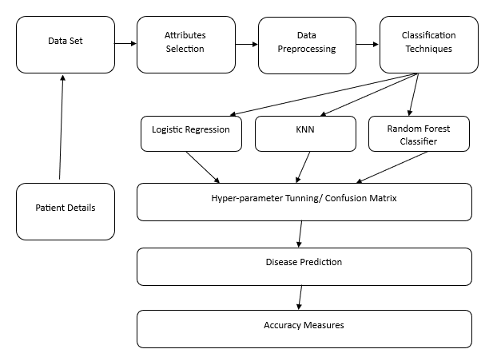
Basic Workflow :-

Slide 5
Literature Review
Paper No. | Publication Year | Author | Title | Methodology
1. | 2020 | Archana Singh; Rakesh Kumar | Heart Disease Prediction Using Machine Learning Algorithms | They summarized in total 4 algorithms namely SVM, Decision tree, Linear regression and KNN, where they on the basis of confusion matrix, they found the KNN to be the best.
2. | 2021 | Simran Verma; Abhishek Gupta | Effective Prediction of Heart Disease Using Data Mining and Machine Learning: A Review | Focused mostly on NLP, tranning-testing reviews and data-set factors.
3. | 2020 | Halima El Hamdaoui; Saïd Boujraf; Nour El Houda Chaoui | A Clinical support system for Prediction of Heart Disease using Machine Learning Techniques | Their research gives point to point explanation of the results showed that NB achieved the highest accuracy compared to other algorithms using both validation techniques. Despite the accuracy is decreased when they applied the cross-validation.

Slide 6
Paper No. | Publication Year | Author | Title | Methodology
4. | 2020 | P. Sujatha; K. Mahalakshmi | Performance Evaluation of Supervised Machine Learning Algorithms in Prediction of Heart Disease | In this research work, heart disease is predicted using decision tree, naïve bayes, SVM, KNN, Logistic Regression and random forest. The classifiers are implemented using Python 3.7 on Heart disease dataset form Kaggle website. From the experimental results it is found that the random forest classifier is more accurate compared to Decision Tree, SVM, Naïve Bayes, Logistic regression and KNN
5. | 2021 | M. Kavitha; G. Gnaneswar; R. Dinesh;Y. Rohith Sai | Heart Disease Prediction using Hybrid machine Learning Model | The proposed work uses a TkInter Python designed application for the heart disease prediction. The proposed system using combinations of Decision Tree and Random forest for heart disease prediction as a hybrid model. Cleveland database is used for this study.
6. | 2019 | Amin Ul Haq; Jianping Li; Muhammad Hammad Memon | Heart Disease Prediction System Using Model Of Machine Learning and Sequential Backward Selection Algorithm for Features Selection | Cleveland heart disease dataset was in this study and 70% for training and 30 % for testing of the dataset. The accuracy metric used for performance evaluation of the system. The experimental results shows that the use of SBS algorithm to choose the appropriate number of features that can be used for better classification accuracy using K-Nearest Neighbor.

Slide 7
Problem Statement
Given clinical parameters about a patient such as age, sex, chest pain, resting blood pressure, fasting blood sugar, and many more ,we can predict whether they have any sort of heart disease?

Slide 8
Objectives
The objective of this project is to check whether the patient is likely to be diagnosed with any cardiovascular heart diseases based on their medical attributes such as gender, age, chest pain, fasting sugar level, etc.
To increase the accuracy rate and efficiency of the machine learning algorithms using hyperpameter tuning.

Slide 9
Proposed Work
We aim on to create an efficient ML model for the prediction using different ML algorithms w.r.t their accuracy rate.
To Make a user-friendly interface for users based on our defined model with all the informativeness required.
Deploy the trained model publicly if we get an accuracy which varies between 0.85~0.99%.

Slide 10
Results Analysis
According to the previously build models their accuracy for almost every model lies in average between 0.72~0.83%
Predicting insights taken are less thus our model will take it deeper.
Less data provided for training and testing sets.
K-Nearest Neighbor (K-NN) In K-NN algorithm a data point is taken whose classification is not available, then the number of neighbors, k is defined. After that k neighbors are selected according to the lowest Euclidian distance between the selected data points and their neighbors
Logistic Regression works by constructing multiple decision trees of the training data, each of the trees predicts a class as an output and the class, which is the output of the greatest number of decision trees is taken as the result, in case of classification.

Slide 11
Conclusion
This project predicts people with cardiovascular disease by extracting the patient medical history that leads to a fatal heart disease from a dataset that includes patients' medical history such as chest pain, sugar level, blood pressure, etc.
Our purpose is to improve the performance of the Random Forest by removing unnecessary and irrelevant attributes from the dataset and only picking those that are most informative for the classification task.

Slide 12
Future Scope
For the future scope more machine learning approach will be used for the best analysis of heart diseases and for earlier prediction of diseases so that the rate of several deaths can be reduced if people are informed of the illness.
As illustrated before the system can be used as a clinical assistant for any clinicians.
The disease prediction through the risk factors can be hosted online and hence any internet users can access the system through a web browser and understand the risk of heart disease.

Slide 13
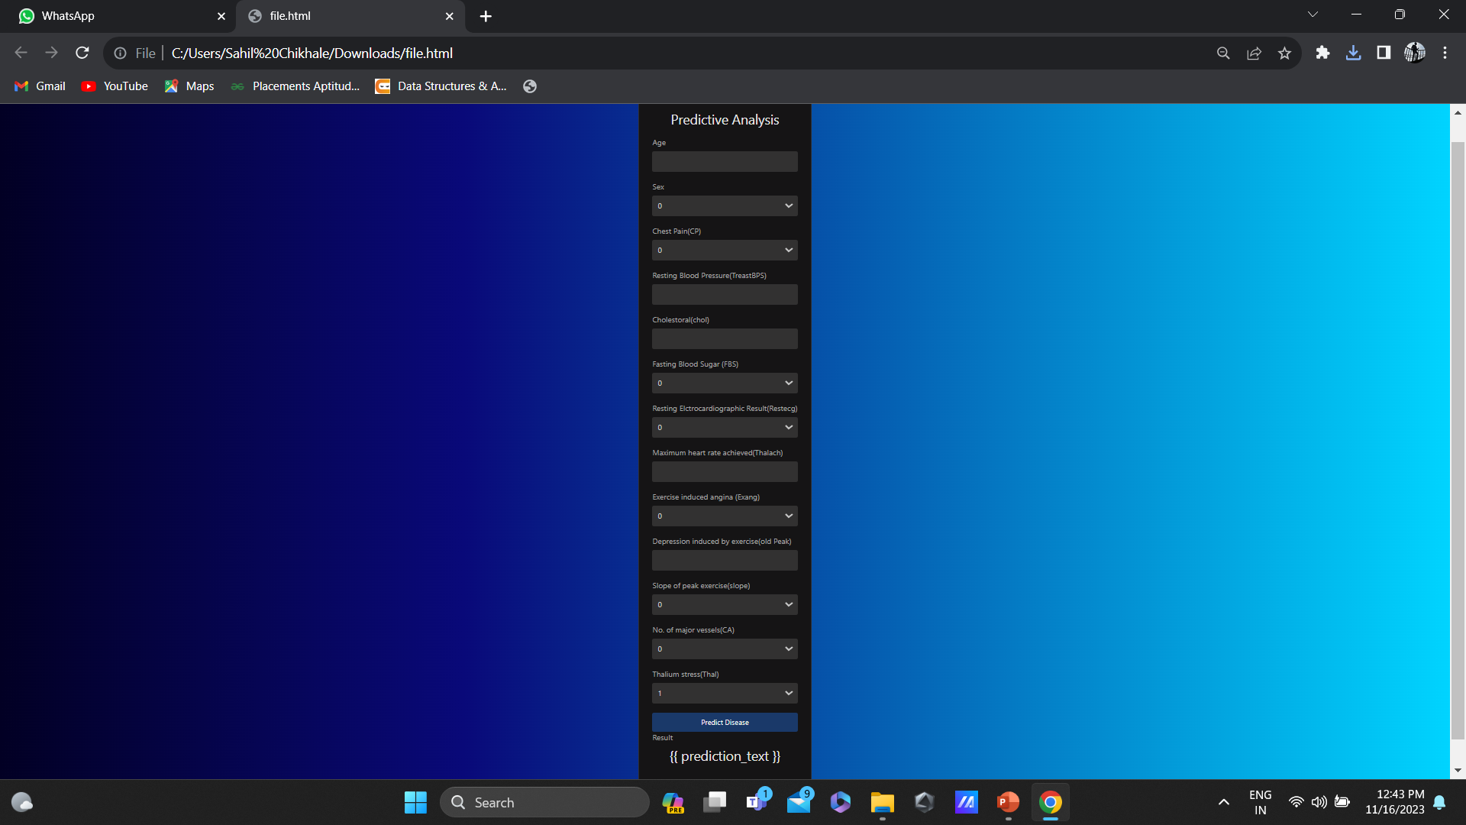
Temporary UI with all the Features

Slide 14
Authors Publication
Effective heart disease prediction using hybrid machine learning techniques
An analysis of heart disease prediction using different data mining techniques
Heart disease prediction using machine learning and data mining technique
Intelligent and effective heart disease prediction system using weighted associative classifiers

Slide 15
References
[1] Archana Singh; Rakesh Kumar (2020).Heart Disease Prediction using Machine Learning Algorithms. International Conference on Electronics and Sustainable Communication Systems (ICESC).
[2] Simran Verma; Abhishek Gupta (2021). Effective Prediction of Heart Disease Using Data Mining and Machine Learning: A Review. International Conference on Artificial Intelligence and Smart Systems (ICAIS).
[3] Halima El Hamdaoui; Saïd Boujraf; Nour El Houda Chaoui; Mustapha Maaroufi (2020). A Clinical support system for Prediction of Heart Disease using Machine Learning Techniques 5th International Conference on Advanced Technologies for Signal and Image Processing (ATSIP).
[4] P. Sujatha; K. Mahalakshmi (2020). Performance Evaluation of Supervised Machine Learning Algorithms in Prediction of Heart Disease. IEEE International Conference for Innovation in Technology (INOCON).
[5] M. Kavitha; G. Gnaneswar; R. Dinesh;Y. Rohith Sai; R. Sai Suraj (2021). Heart Disease Prediction using Hybrid machine Learning Model. 6th International Conference on Inventive Computation Technologies (ICICT).
[6] Amin Ul Haq; Jianping Li; Muhammad Hammad Memon; Muhammad Hunain Memon (2019). Heart Disease Prediction System Using Model Of Machine Learning and Sequential Backward Selection Algorithm for Features Selection. IEEE 5th International Conference for Convergence in Technology (I2CT).

Slide 16
Thank You

